Slide 1
A Presentation on RAID
PRESENTED BY:
UNIKA SHAKYA
730348

Slide 2
INTRODUCTION TO RAID
RAID stands for Redundant Arrays of Independent Disks or Redundant Array of Inexpensive Disks.
It is a technique which makes use of a combination of multiple disks instead of using a single disk for increased performance, data redundancy or both.
The term was coined by David Patterson, Garth A. Gibson, and Randy Katz at the University of California, Berkeley in 1987.

Slide 3
RAID LEVELS
Depending on the required level of redundancy and performance, data is distributed across the drives in one of several ways, referred to as RAID levels.
The different data distribution layouts are named by the word "RAID" followed by a number, for example RAID 0 or RAID 1. Each RAID level provides a different balance among the key goals : reliability, availability, performance, and capacity.
Originally, there were RAID 0- RAID 5.

Slide 4
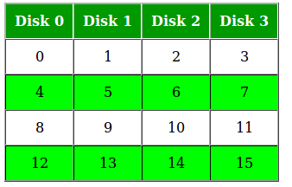
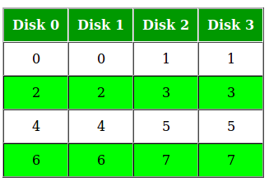
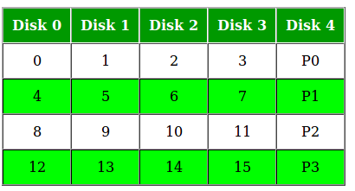
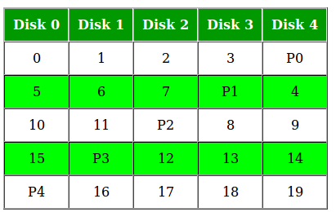
RAID LEVELS
RAID 0 RAID 1
RAID 4 RAID 5

Slide 5
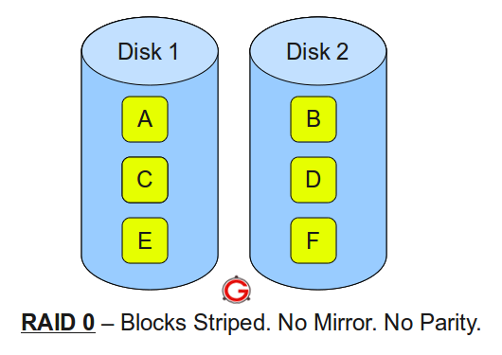
RAID 0
Minimum 2 disks.
Excellent performance ( as blocks are striped ).
No redundancy ( no mirror, no parity ).

Slide 6
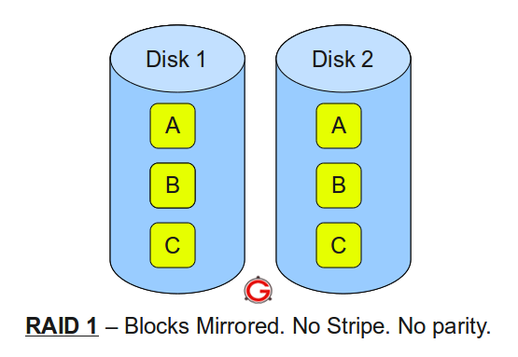
RAID 1
Minimum 2 disks.
Good performance ( no striping. no parity ).
Excellent redundancy ( as blocks are mirrored ).

Slide 7
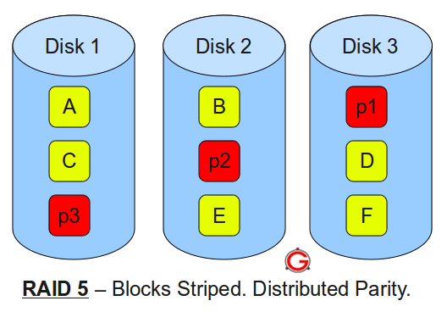
RAID 5
Minimum 3 disks.
Good performance ( as blocks are striped ).
Good redundancy ( distributed parity ).
Best cost effective option providing both performance and redundancy.

Slide 8
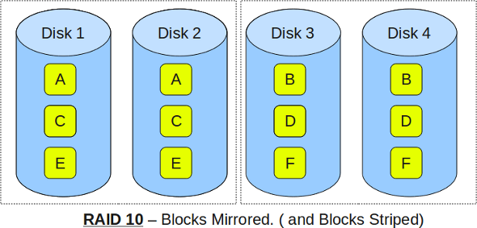
RAID 10(1+0)
Minimum 4 disks.
This is also called as “stripe of mirrors”
Excellent redundancy ( as blocks are mirrored )
Excellent performance ( as blocks are striped )

Slide 9
WEAKNESSES OF RAID
Correlated failures
Nested RAID levels are more expensive to implement than traditional RAID levels because they require a greater number of disks
Some RAID levels can only sustain a single drive failure.
Increasing rebuild time and failure probability
There is a chance the remaining disks may contain bad sectors or unreadable data. These types of conditions may make it impossible to fully rebuild the array.

Slide 10
THANK-YOU!!

